Slide 1
Create and organize
schemas
Create and organize schemas

Slide 2
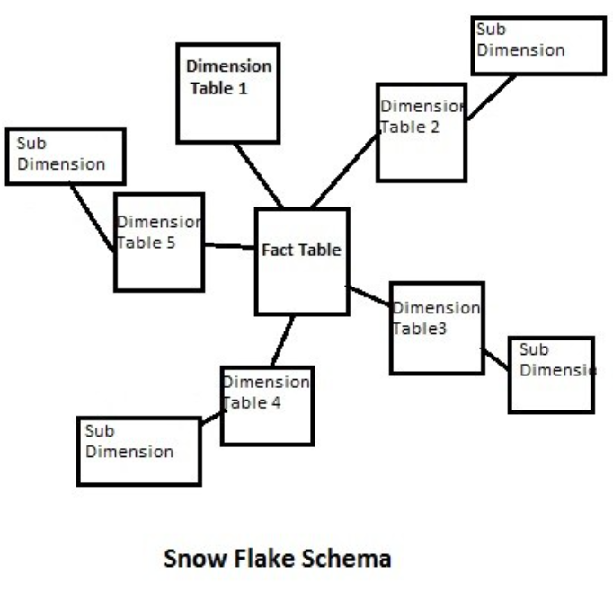
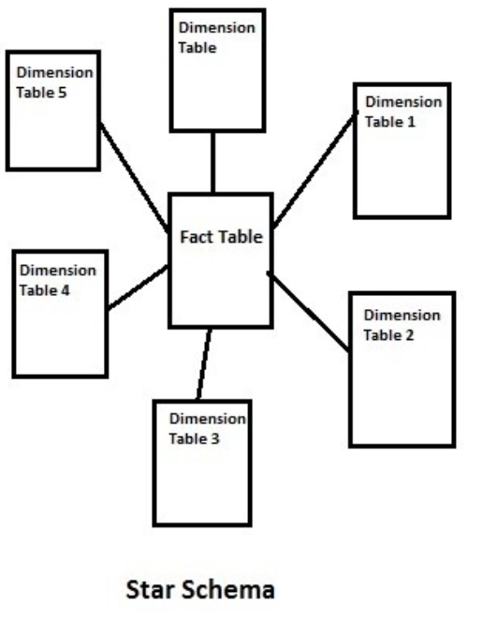
Create and organize diagrams
Note: This lab uses the lab2.xlsx file in the Sales Model template
Objective: Transform the Inmon model schema (snowflake schema) to Kimball (star schema)

Slide 3
Create and organize diagrams
Load the data into Power BI Desktop.
Implement the star schema (Kimball Approach ) ensuring that FactSales is
directly connected to
DimProduct
DimCustomer
DimDate
De-normalize all dimension tables (eg. DimProduct must include DimCategory ).

Slide 4
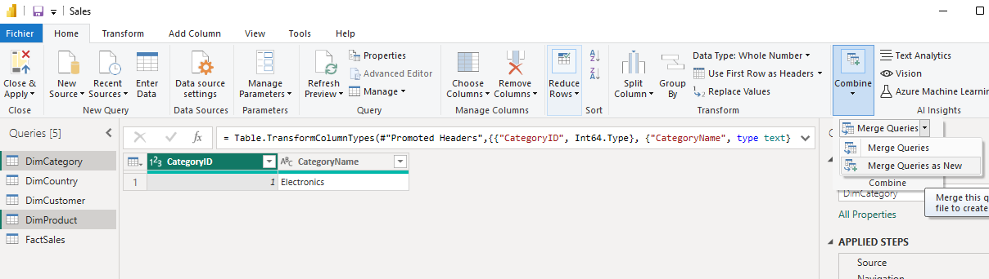
Create and organize diagrams
De-normalize all dimension tables (eg. DimProduct must include DimCategory ).

Slide 5
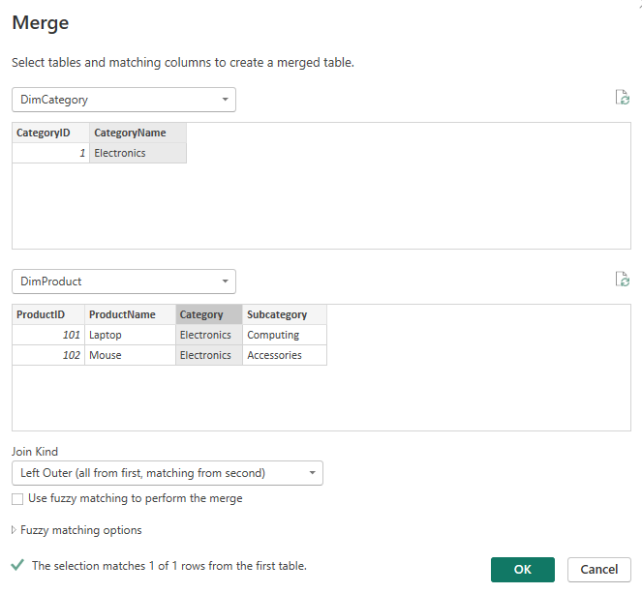
Create and organize diagrams
Select " CategoryName " from DimCategory and " CategoryColumn " since DimProduct .

Slide 6
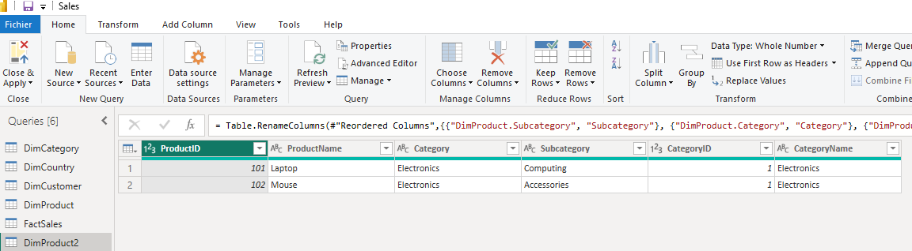
Create and organize diagrams
Create, clean, and reformat a new DimProduct2 table in Power Query Editor .

Slide 7
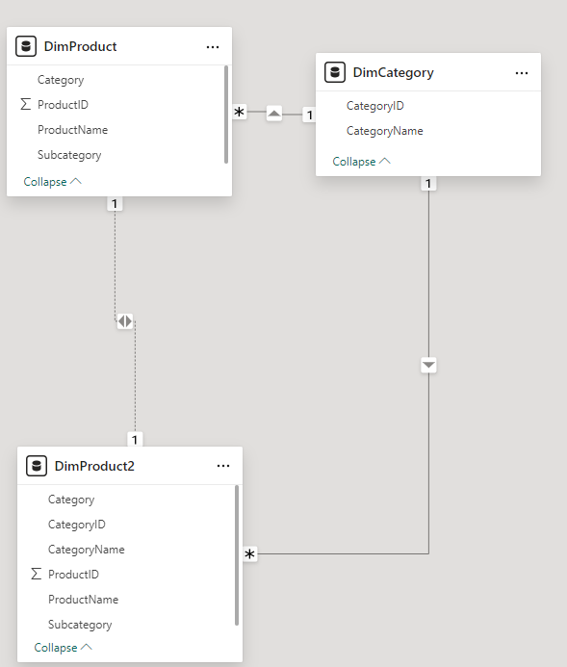
Create and organize diagrams
Delete existing relationships, if they exist.

Slide 8
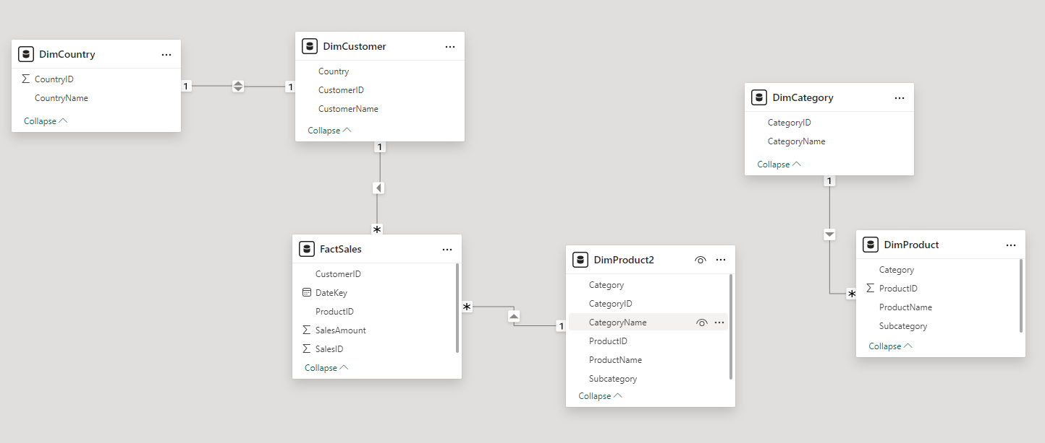
Create and organize diagrams
Establish the relationship between DimProduct2 and FactSales by dragging ProductID from FactSales to DimProduct2 .

Slide 9
Create and organize diagrams
Merge DimCustomer and DimCountry to generate DimCustomer2 .

Slide 10
Create and organize diagrams
Restructure DimCustomer2 in the same way as the other dimensions.

Slide 11
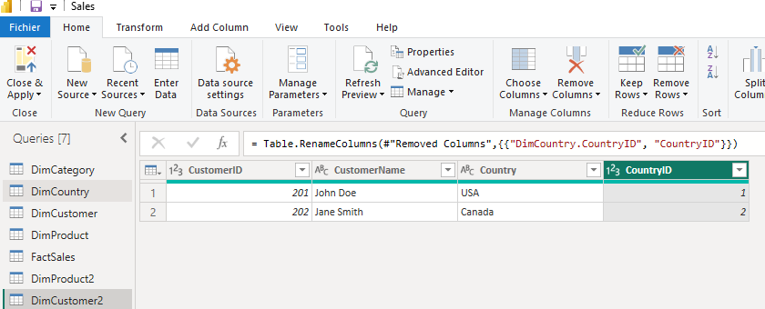
Create and organize diagrams
Restructure DimCustomer2 in the same way as the previous dimensions

Slide 12
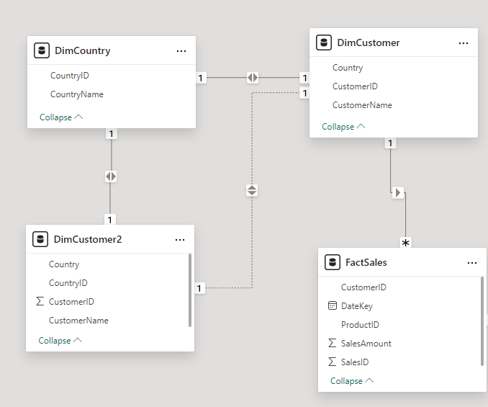
Create and organize diagrams
Delete relationships if they exist

Slide 13
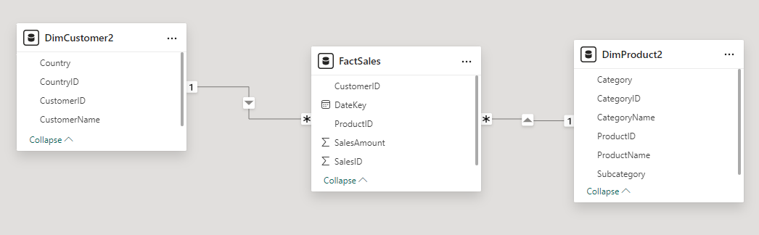
Create and organize diagrams
Now let's establish a new connection between DimCustomer2 and FactSales
by dragging CustomerID from FactSales to DimCustomer2 , this is the Kimball star schema.

Slide 14
Thank you
Thank you

